Slide 1
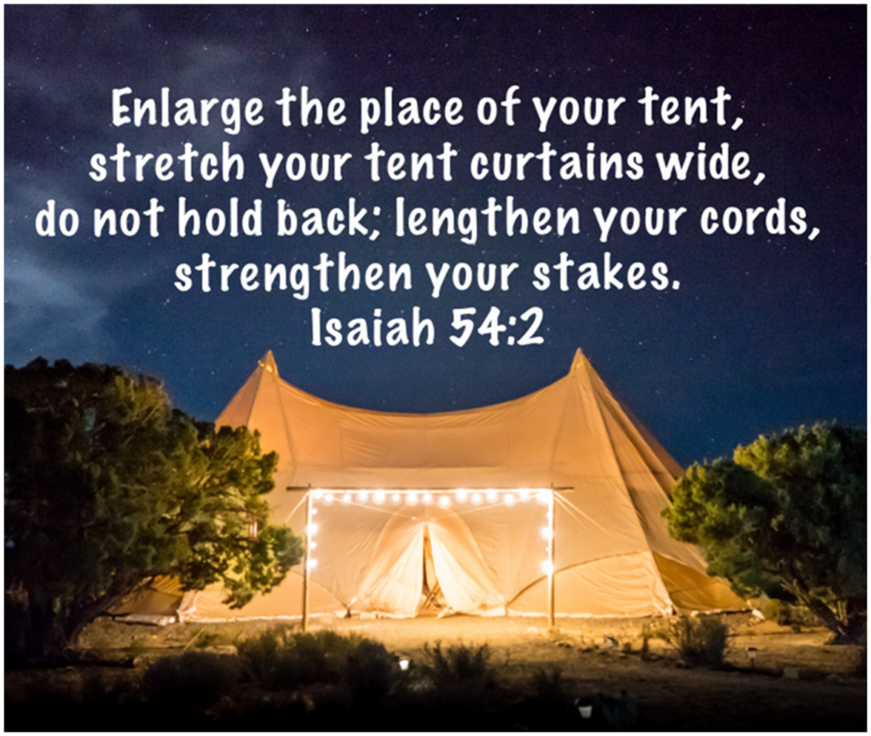
Welcome
Summer series
Our verse of the year

Slide 3
I Thank God (lyrics) - YouTube

Slide 5
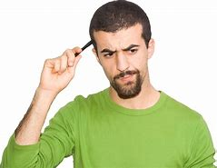
Theme for the summer
What do you need for a tent?

Slide 6
Theme for the summer
Place – Enlarge the place Ruth and Paul
Material/Curtains – Stretch out your curtains Grace
Ropes/Cords – Lengthen your cords Vic
Poles/Stakes – Strength your stakes Ramona
Summing up and BBQ Paul

Slide 8
CeCe Winans - Never Lost (Official Lyric Video) - YouTube

Slide 11
John 1 v 14 - 18
The Word became flesh and made his dwelling among us. We have seen his glory, the glory of the one and only Son, who came from the Father, full of grace and truth.
John testified concerning him. He cried out, saying, “This is the one I spoke about when I said, ‘He who comes after me has surpassed me because he was before me.’” Out of his fullness we have all received grace in place of grace already given.
For the law was given through Moses; grace and truth came through Jesus Christ. No one has ever seen God, but the one and only Son, who is himself God and is in closest relationship with the Father, has made him known.

Slide 12
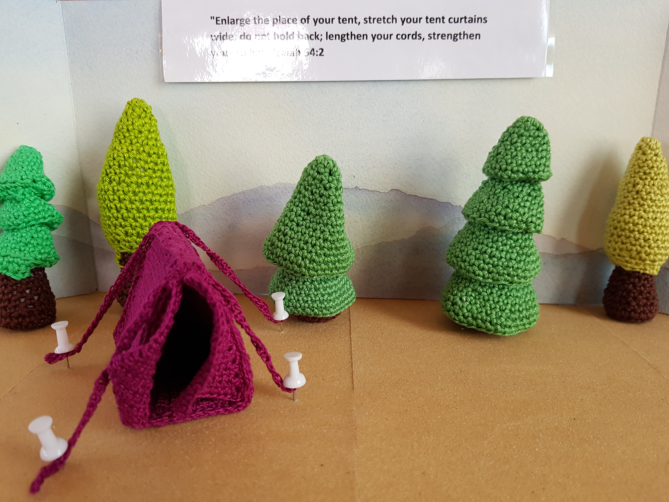
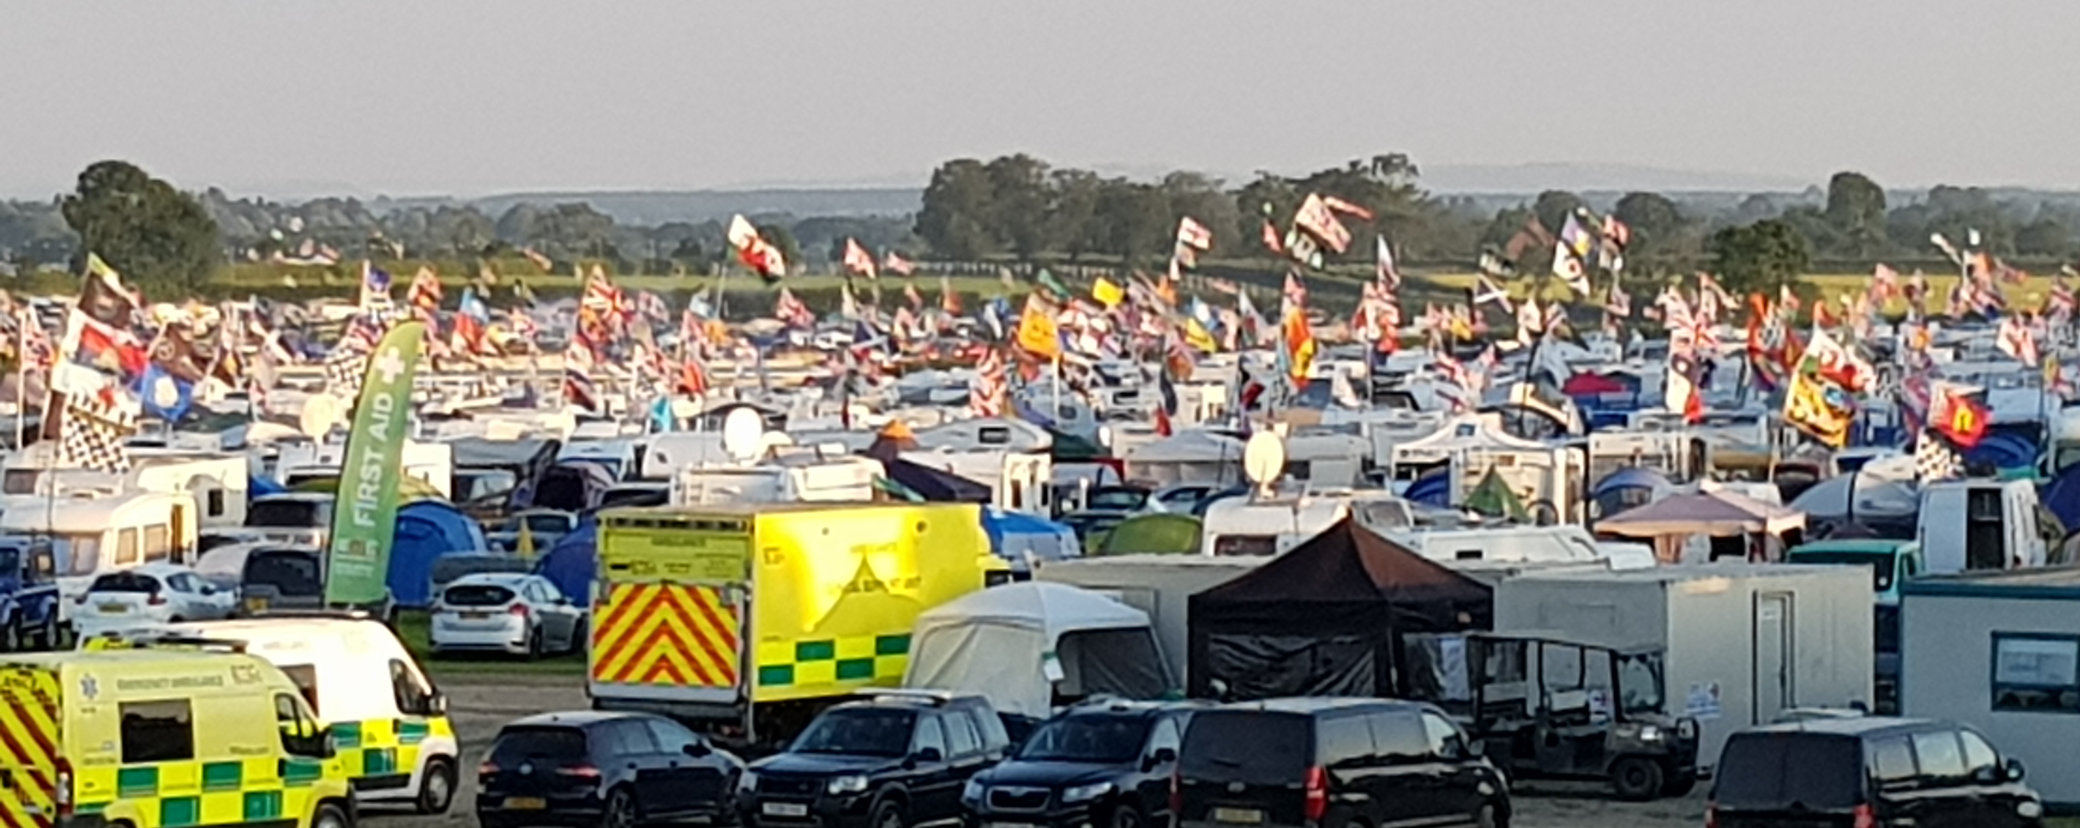
Prayer Campsite

Slide 13
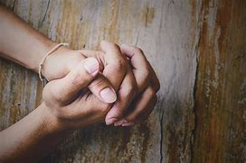
The Lord’s Prayer
Our Father in heaven,
hallowed be your name,
your kingdom come,
your will be done,
on earth as in heaven.
Give us today our daily bread.
Forgive us our sins
as we forgive those who sin against us.
Lead us not into temptation
but deliver us from evil.
For the kingdom, the power,
and the glory are yours
now and for ever.
Amen.

Slide 14
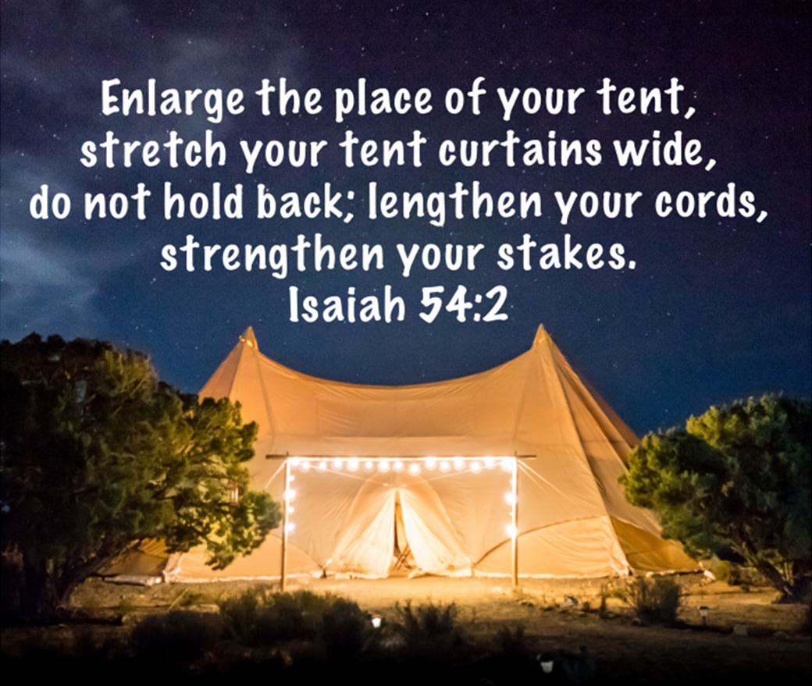

Slide 15
https://www.youtube.com/watch?v=fhS83a5Ky84

Slide 17
Getting the ground ready (getting everything ready)

Slide 18
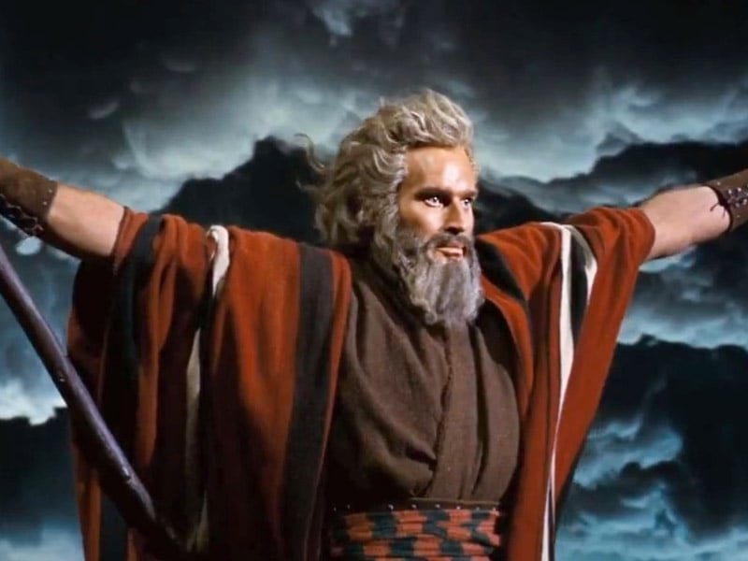
Exodus 33 v 11
The Lord would speak to Moses face to face, as one speaks to a friend.
Then Moses would return to the camp, but his young aide Joshua son of Nun did not leave the tent.

Slide 19
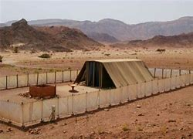
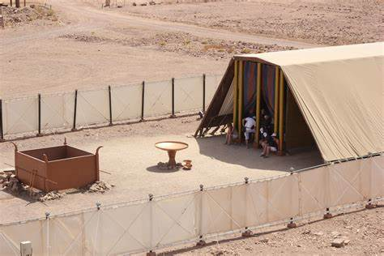
Tent of Meeting

Slide 20
Psalm of David – Psalm 15 v1-5
Lord, who may dwell in your sacred tent? Who may live on your holy mountain?
The one whose walk is blameless, who does what is righteous, who speaks the truth from their heart; whose tongue utters no slander, who does no wrong to a neighbour, and casts no slur on others; who despises a vile person but honours those who fear the Lord; who keeps an oath even when it hurts, and does not change their mind; who lends money to the poor without interest; who does not accept a bribe against the innocent.
Whoever does these things will never be shaken.

Slide 21
John 1 v 14 - 18
The Word became flesh and made his dwelling among us. We have seen his glory, the glory of the one and only Son, who came from the Father, full of grace and truth.
John testified concerning him. He cried out, saying, “This is the one I spoke about when I said, ‘He who comes after me has surpassed me because he was before me.’” Out of his fullness we have all received grace in place of grace already given.
For the law was given through Moses; grace and truth came through Jesus Christ. No one has ever seen God, but the one and only Son, who is himself God and is in closest relationship with the Father, has made him known.

Slide 22
Romans 3 v 21-24
But now apart from the law the righteousness of God has been made known, to which the Law and the Prophets testify.
This righteousness is given through faith in Jesus Christ to all who believe.
There is no difference between Jew and Gentile, for all have sinned and fall short of the glory of God, and all are justified freely by his grace through the redemption that came by Christ Jesus.

Slide 23
Getting the ground ready (getting everything ready)
Two aspects:
Physical ground – church building, our finances, our processes, etc.
Ourselves

Slide 24
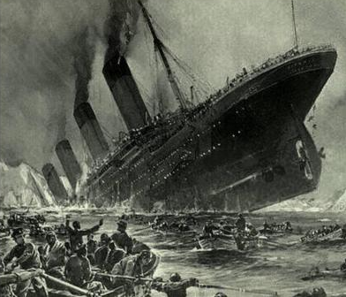
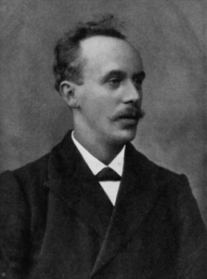
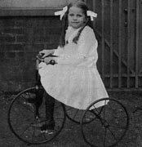
John Harper

Slide 26
House of Miracles (Lyrics) - Brandon Lake & Bethel Music - YouTube

Slide 27
Next week
Place - Enlarge the place
Ruth and Paul

